Slide 1
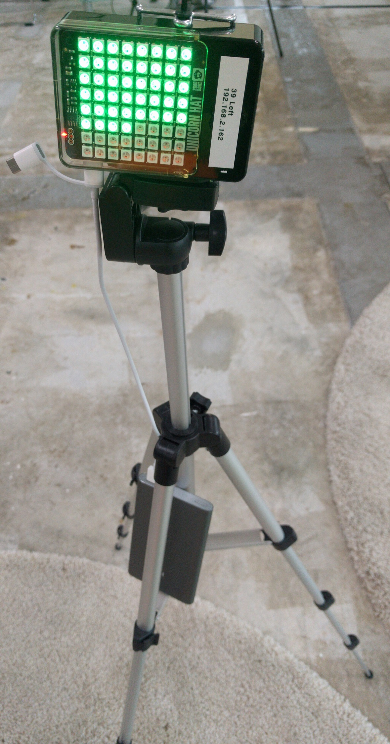
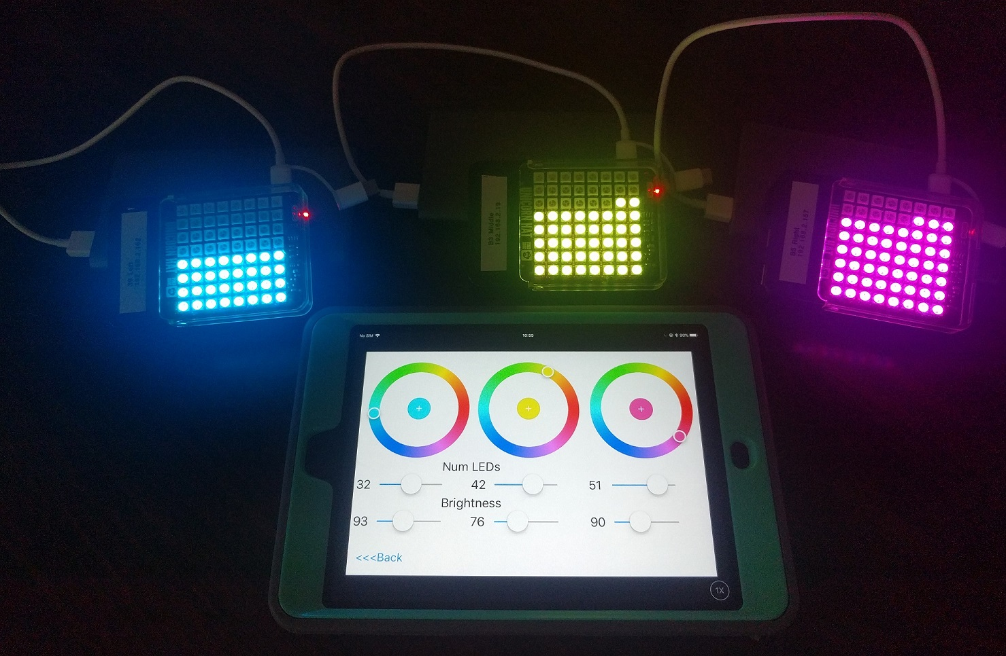
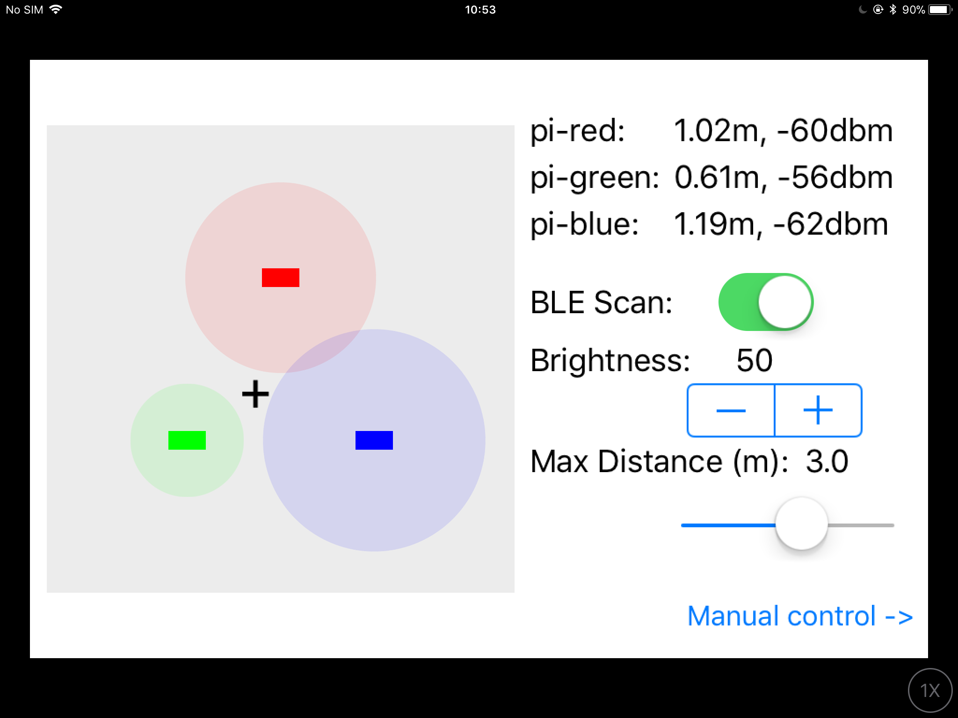
BLE Localiser
iOS Conf SG (19-20 Oct 2017)
By: Yeo Kheng Meng (yeokm1@gmail.com)
https://github.com/yeokm1/ble-localiser

Slide 2
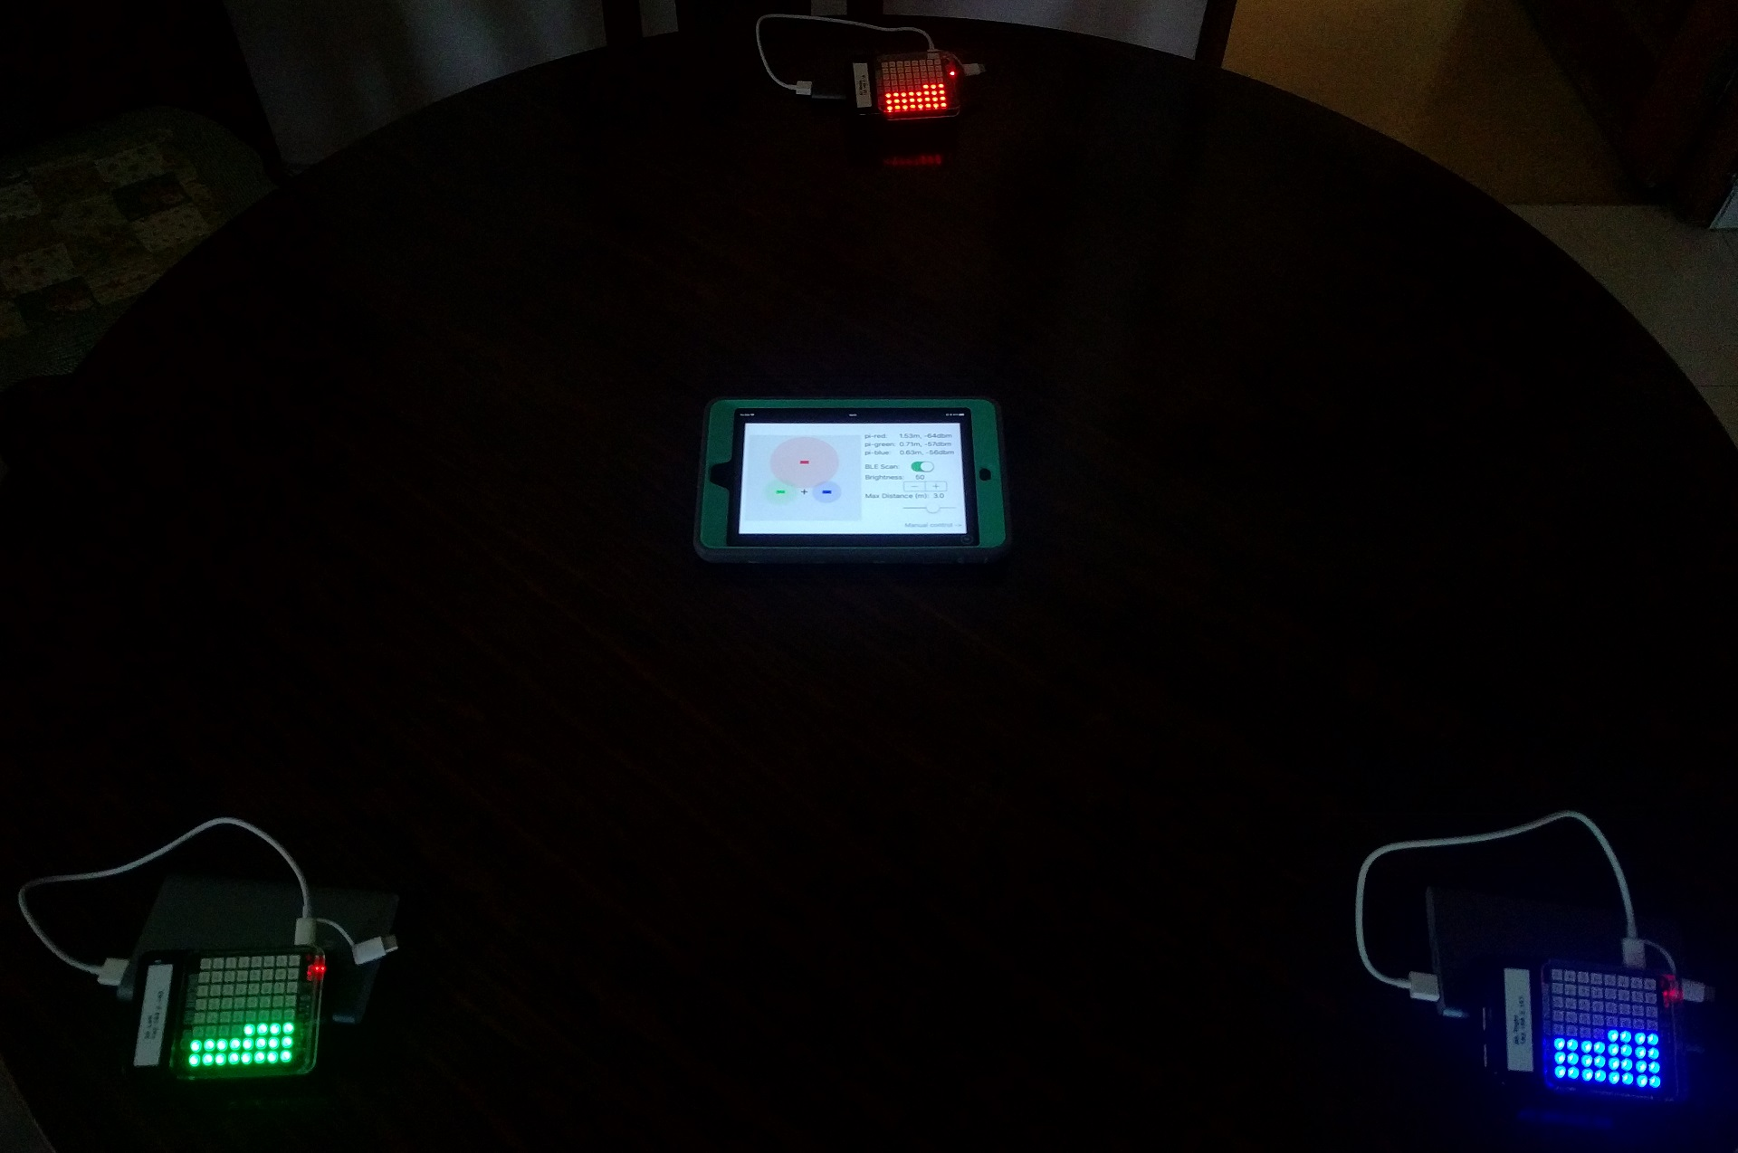
Demo
BLE Localisation
Manual Control

Slide 3
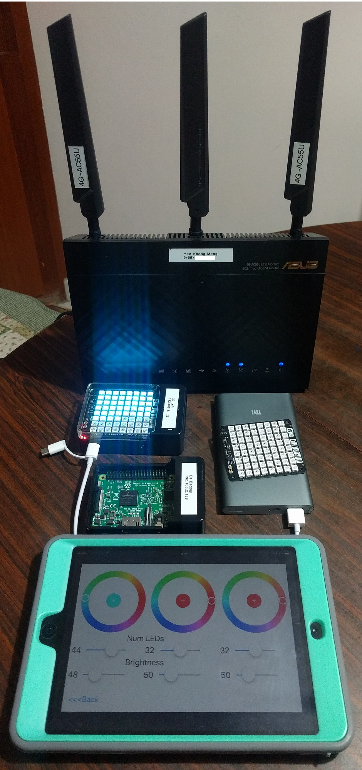
The hardware
Raspberry Pi 3
Wifi, Bluetooth (LE)
Raspbian OS
Pimoroni Unicorn Hat
8 x 8 RGB LEDs
Python Library provided by manufacturer
iPad Mini 2 + Swift App
Supporting Gear
Asus 4G-AC55U Wifi Router
3x Tripod
3x Xiaomi 10000mAh Power Bank

Slide 4
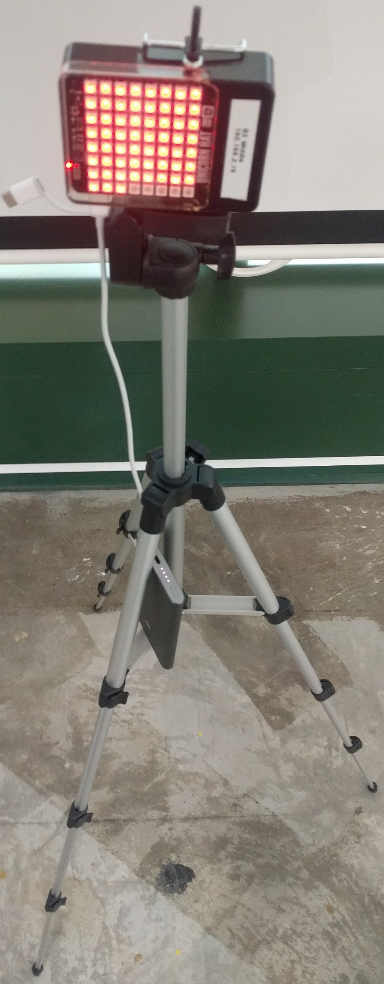
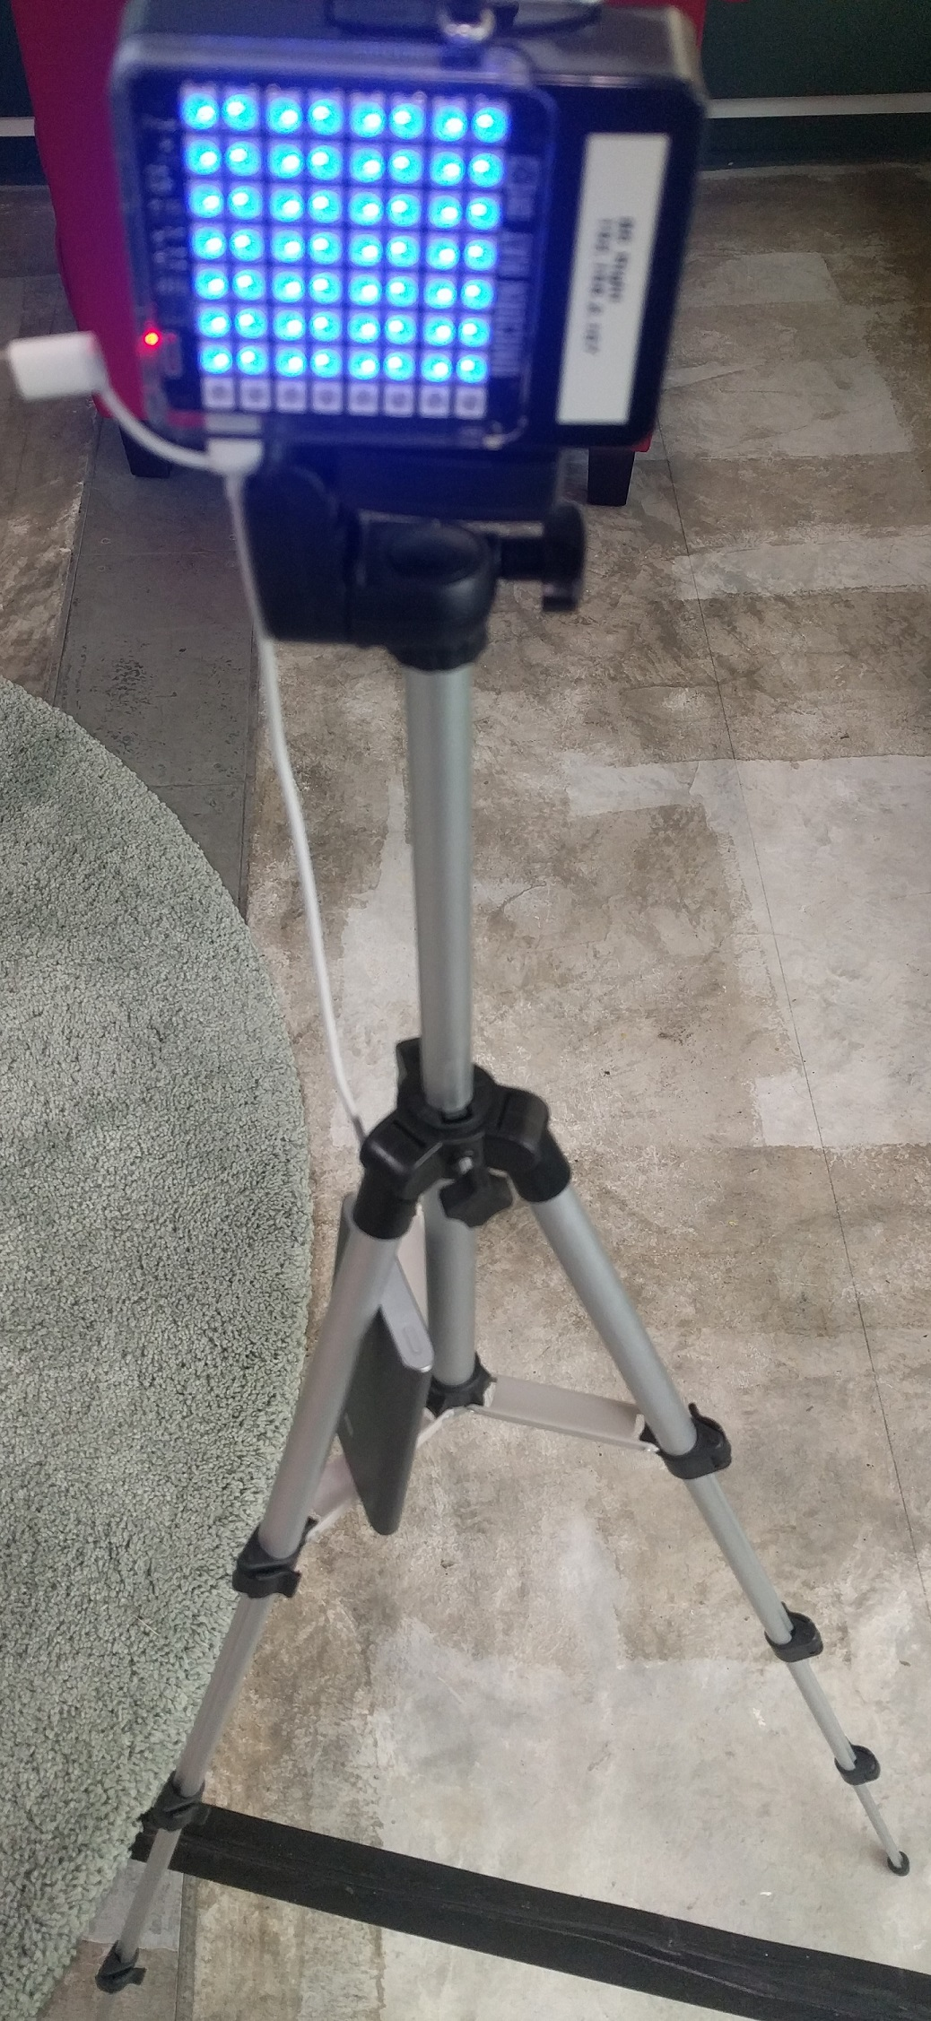
Layout
2m
2m
2m

Slide 5
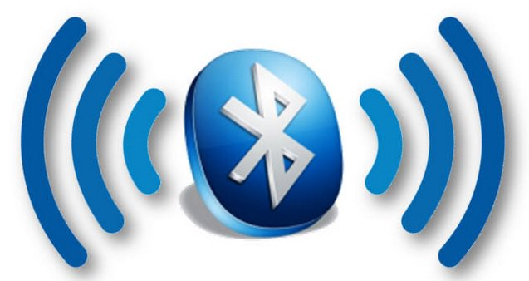
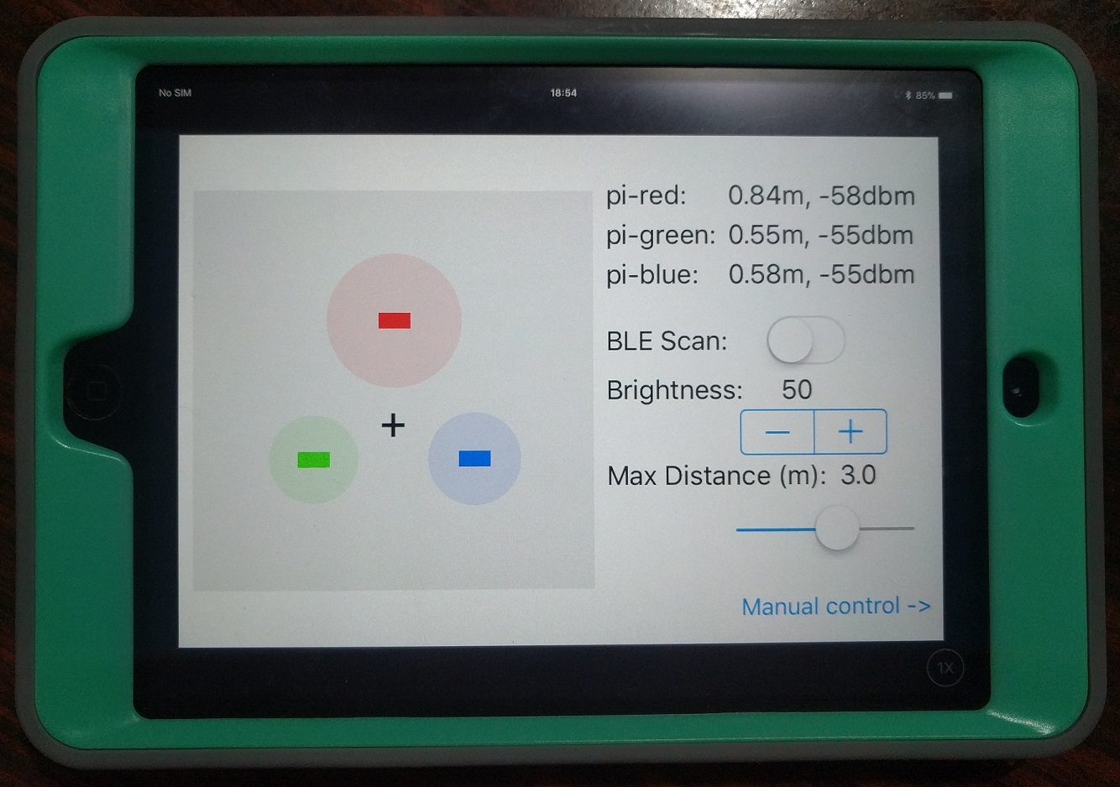

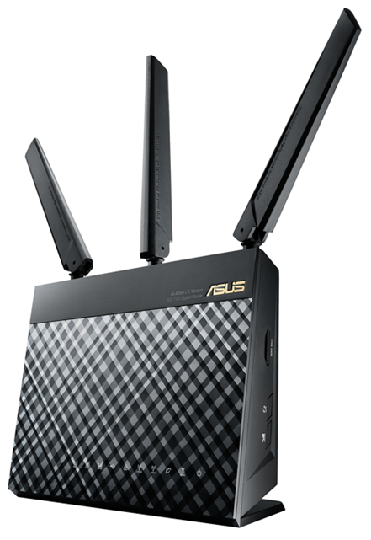
System overview
Advertisement Packets
x LEDs + colour

Slide 6
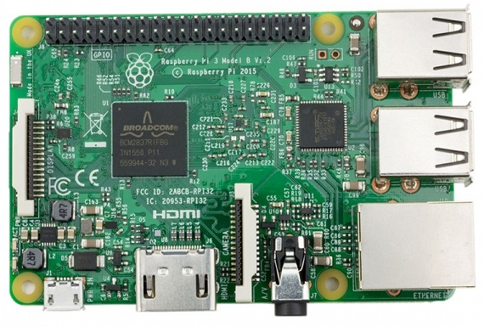
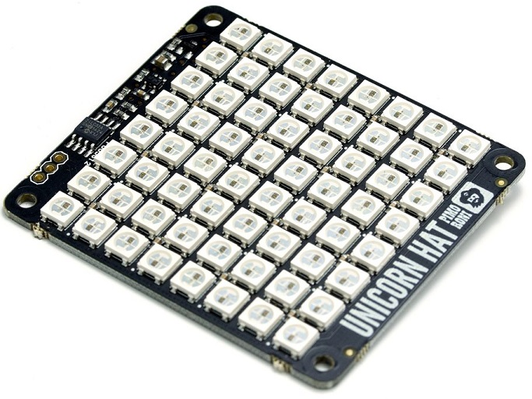


Workflow
Receive signal strength of advertisement packets
Unicorn Library
n x RGB (255, 255, 255)
Unix Domain Socket
Calculate and send LED information
via UDP
n x RGB (255, 255, 255)
Listening UDP Socket
Listening Unix Domain Socket

Slide 7
Getting BLE RSSI on iOS?
Received Signal Strength Indicator
BLE Scan with Duplicate keys enabled
centralManager.scanForPeripherals(withServices: nil, options: [CBCentralManagerScanOptionAllowDuplicatesKey : true])
Get Relative Signal Strength Indication (RSSI) in dBm
CBCentralDelegate
func centralManager(_ central: CBCentralManager, didDiscover peripheral: CBPeripheral, advertisementData: [String : Any], rssi: NSNumber)

Slide 8
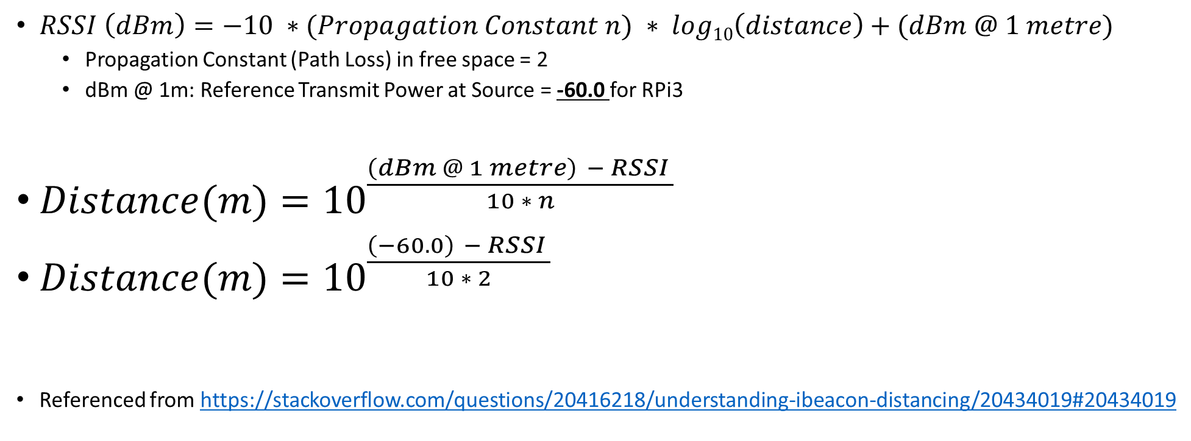
Distance(m) <-> RSSI formula
$RSSI \left(dBm\right)=−10 ∗(Propagation Constant n) ∗ log10\left(distance\right)+(dBm @ 1 metre)$
Propagation Constant (Path Loss) in free space = 2
dBm @ 1m: Reference Transmit Power at Source = -60.0 for RPi3
$Distance(m)={10}^{\frac{\left(dBm @ 1 metre\right) − RSSI }{10 ∗ n}}$
$Distance(m)={10}^{\frac{\left(−60.0\right) − RSSI }{10 ∗ 2}}$
Referenced from https://stackoverflow.com/questions/20416218/understanding-ibeacon-distancing/20434019#20434019

Slide 9
But RSSI values fluctuate widely…

Slide 10
Do a Trimmed Mean
Trim outlier values from a set
Obtain values in a fixed queue
Sort the values
Remove the 20% outliers and average the rest -> 1.43m
Oldest |  |  |  |  |  |  |  |  | Newest
1.1 | 5.0 | 1.4 | 1.2 | 0.1 | 1.6 | 0.2 | 1.5 | 1.8 | 4.9
Smallest |  |  |  |  |  |  |  |  | Largest
0.1 | 0.2 | 1.1 | 1.2 | 1.4 | 1.5 | 1.6 | 1.8 | 4.9 | 5.0
Smallest |  |  |  |  |  |  |  |  | Largest
 |  | 1.1 | 1.2 | 1.4 | 1.5 | 1.6 | 1.8

Slide 11
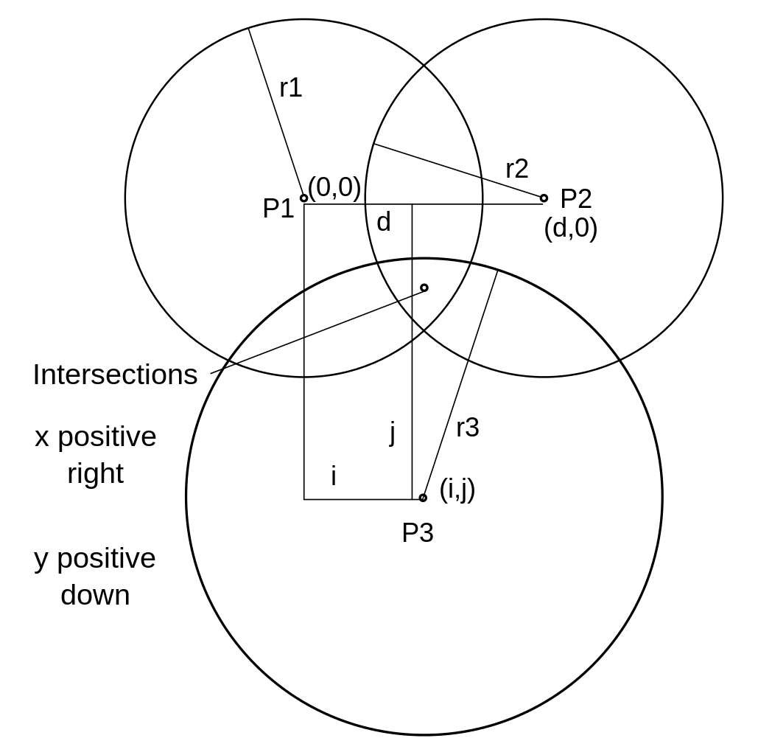
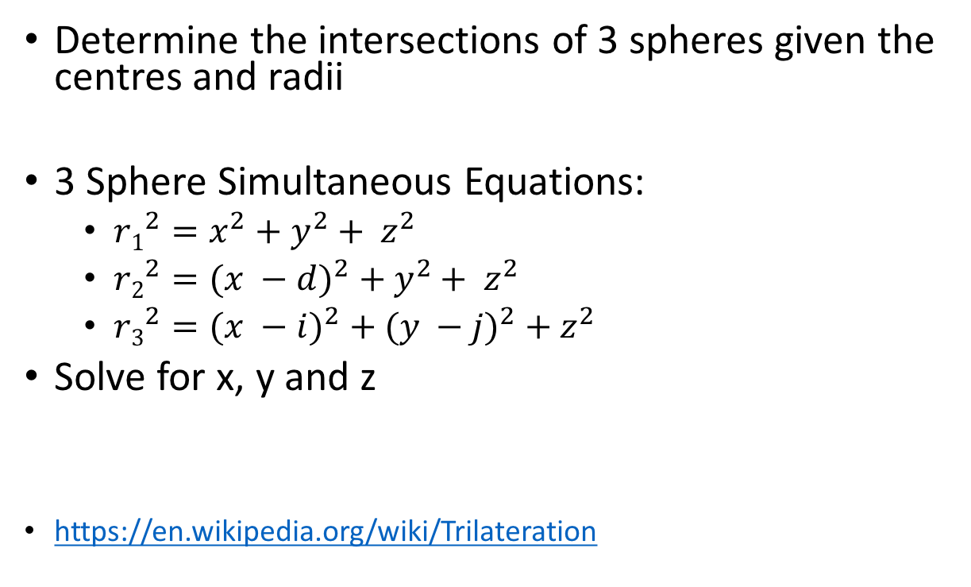
Trilateration of 3 beacon distances
Determine the intersections of 3 spheres given the centres and radii
3 Sphere Simultaneous Equations:
$r1^{2}=x^{2}+y^{2}+ z^{2}$
$r2^{2}={(x −d)}^{2} + y^{2}+ z^{2}$
$r3^{2}={(x −i)}^{2} + {(y −j)}^{2} + z^{2}$
Solve for x, y and z
https://en.wikipedia.org/wiki/Trilateration

Slide 12

Check out the SP Booth to find out more

Slide 13
Lets try averaging the last few values?
Implement a fixed queue
Average of values -> 1.8m
Oldest |  |  |  |  |  |  |  |  | Newest
1.1 | 5.0 | 1.4 | 1.2 | 0.1 | 1.6 | 0.2 | 1.5 | 1.8 | 4.9

Slide 14
Compile Swift Apps on RPi
Raspbian now supported together with Ubuntu
Swift 3.1.1 with Swift Package Manager for Raspbian
https://www.uraimo.com/2017/09/06/A-small-update-on-Swift-for-raspberry-pi-zero-1-2-3/
sudo apt install libpython2.7 clang

Slide 15
Cross compile ARM Swift apps on your Mac
Supports only up to Swift 3.0.2
Build the Swift Package Manager that supports Swift 3.0.2
Checkout the 30 April 2017 commit:
git clone https://github.com/apple/swift-package-manager.git
git checkout 09a6bf19b4e31d9348d98efd9db09298da152315
Look out for libraries that require system header directory
Eg. https://github.com/PureSwift/CSwiftBluetoothLinux
/usr/include/…
Go to Recovery mode to disable System Integrity Protection (SIP)

